Slide 1
IBM Data Science Certificate Capstone Project: Car Accident Severity Classification
Melissa Melancon
September 2020

Slide 2
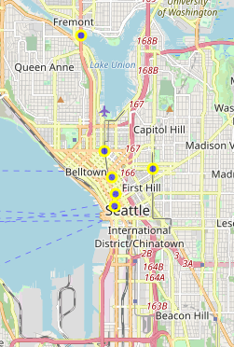
Introduction and Business Understanding
There are more than 6 million car accidents in the United States each year [1]
Car accidents result in more than 36,500 deaths or 2.7 million injuries [1]
This project aims to model attributes that will predict the severity of car accidents
Based on data from Seattle, WA from 2004-present [2]
[1] - National Highway Traffic Safety Administration, https://crashstats.nhtsa.dot.gov/#!/#%2F
[2] – Coursera data set and Metadata file with explanations, https://www.coursera.org/learn/applied-data-science-capstone/supplement/Nh5uS/downloading-example-dataset

Slide 3
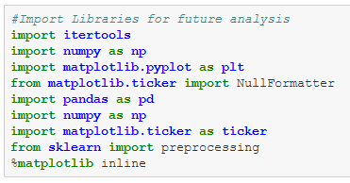
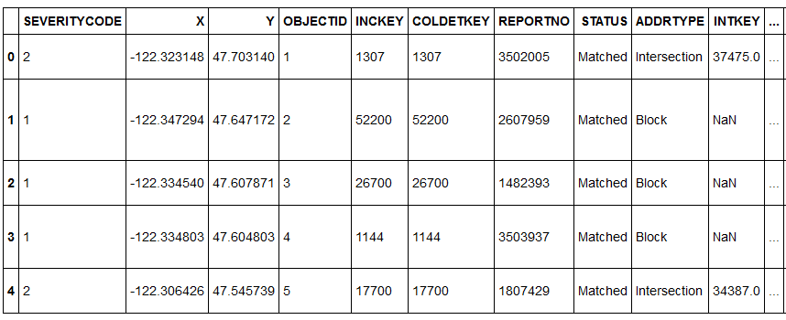
Data Understanding
Created Jupyter Notebook
Modelled data in Python with multiple libraries
Imported Coursera data and developed data frame for analysis
More than 196,000 rows and 38 columns
Focused on data that had greatest impact on car accidents

Slide 4
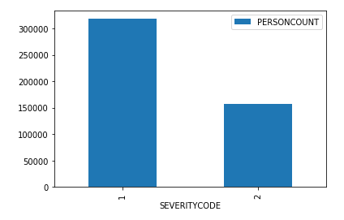
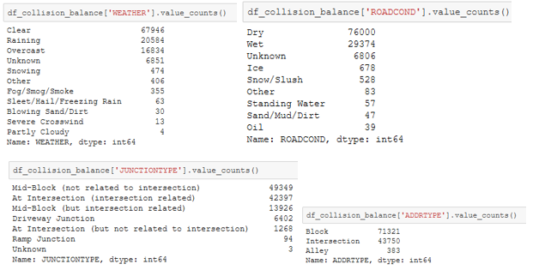
Data Preparation
Started with data analysis on types of car accidents
Severity Code 1 = Property Damage
Severity Code 2 = Injury to a Person
Evaluated biggest factors/contributors involved in accidents
Developed list of columns to remove (ie: codes rather than real data)
Developed full list of columns / criteria to include:
Address Type, Weather, Road Conditions all included in first model
Second model added Junction Type, Collision Type, and Vehicle Count (see conclusion section for reasoning behind second model development)

Slide 5
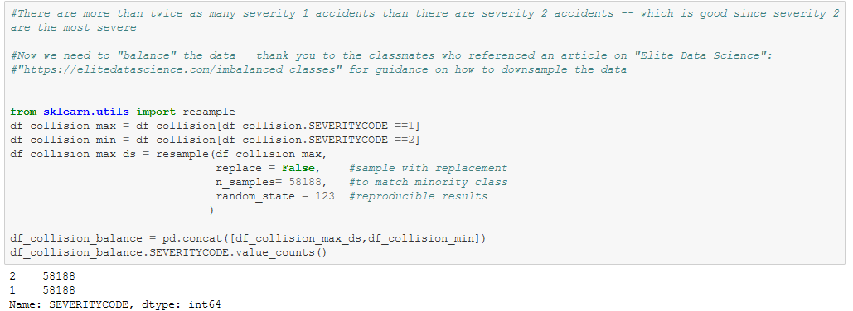
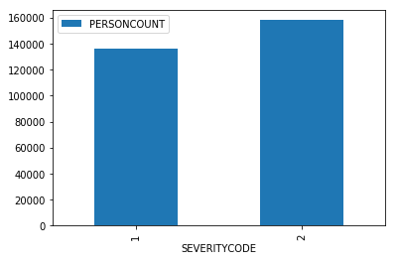
Data Preparation (cont.)
Performed “downsampling” after learning about the importance of balancing data [3]
As noted in the code and shown in the top bar chart on the right, there were twice as many car accidents involving property damage than injury
Downsampling removes some of the counts from the “majority” class (the severity 1 accidents in this case) to balance the data – in this case, the dataframe created an even distribution of severity 1 and severity 2 codes
An interesting observation was that after downsampling, the dataframe contained more severity 2 cases
[3] - https://elitedatascience.com/imbalanced-classes

Slide 6
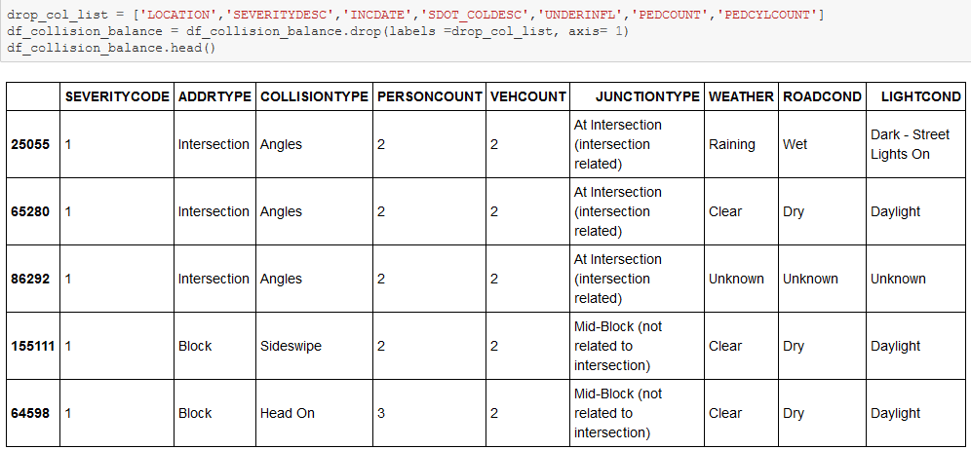
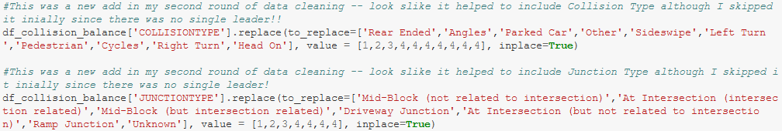
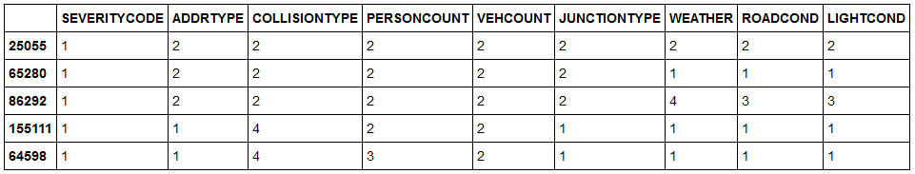
Data Preparation (cont.)
Created simplified dataframe with 9 columns
Normalized those columns from objects to numbers to improve testing / modelling
“Data Scientists spend 80% of their time on data cleaning” – Dan Riley

Slide 7
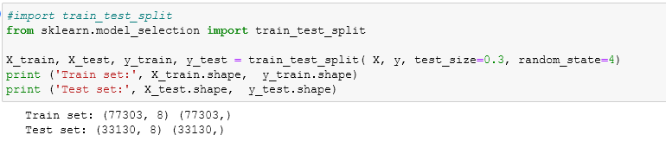
Data Modelling and Evaluation
Developed model to Target Variable, Y, against the 9 independent variables, X
Ran three Classification Algorithm Models:
K-Nearest Neighbors
Decision Tree
Support Vector Machine
Calculated F1 and Jaccard scores to determine accuracy of models

Slide 8
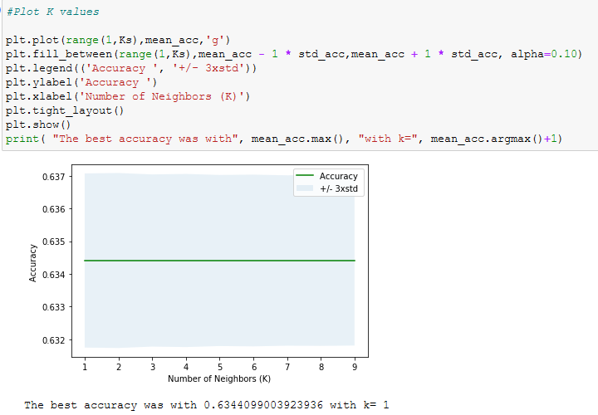
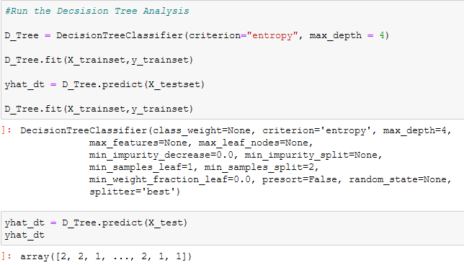
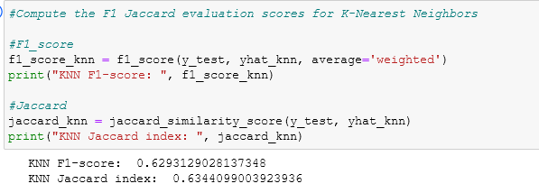
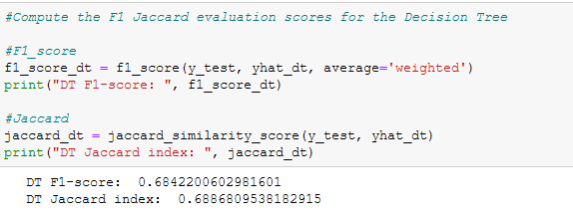
Data Modelling and Evaluation (cont.)
K-Nearest Neighbors
Decision Tree

Slide 9
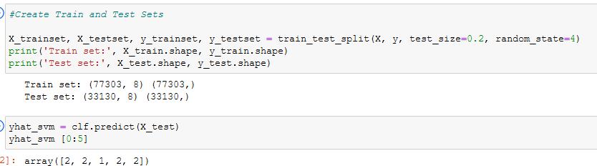
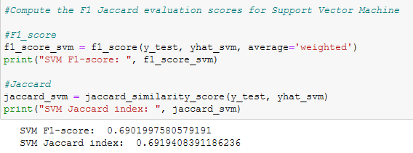
Data Modelling and Evaluation (Cont.)
Support Vector Machine

Slide 10
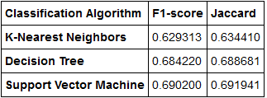
Data ConclusionS
F1 and Jaccard Scores between 63 – 69% which shows correlation of 9 variables to severity of an accident
Improved results over first data modelling without Junction Type, Collision Type, and Vehicle Count
Each of those F1 and Jaccard Scores between 55 – 60%
Importance of rerunning models with different variables to improve results
Would further recommend adding new data fields such as age or drive or type of car to try to improve modelling before large scale deployment (these were not included in the data set, but were statistics that the National Highway Traffic Safety Administration modelled [1])
Results Table

